Slide 1
Analysis of Selected Health Issues

Slide 2
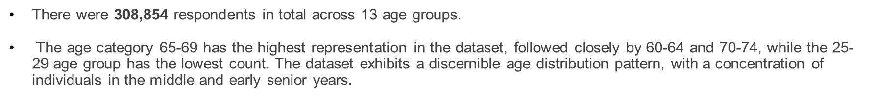
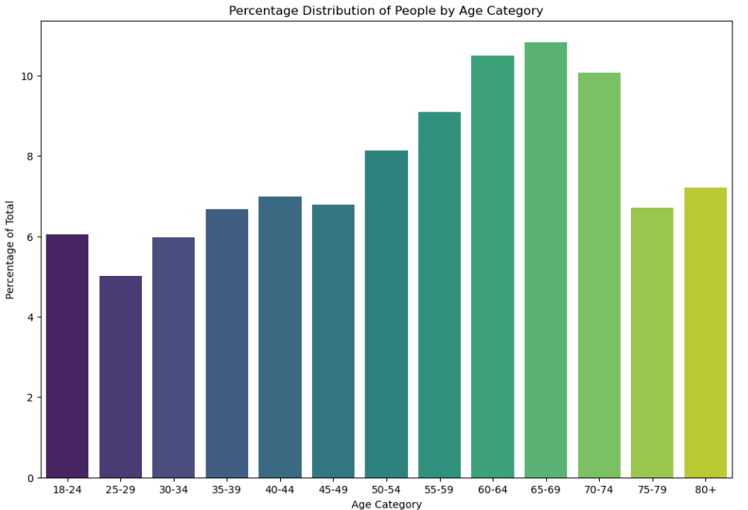
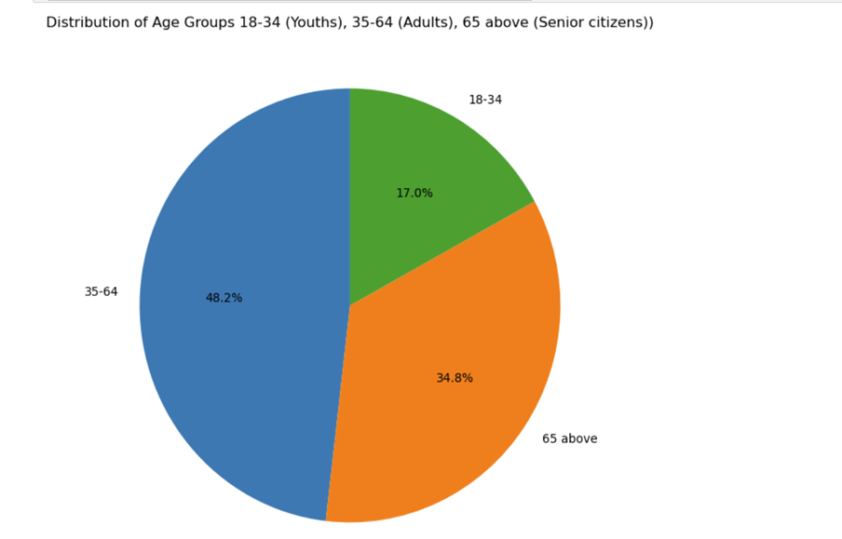
Dataset Highlights

Slide 3
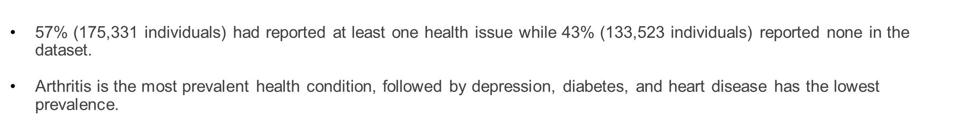
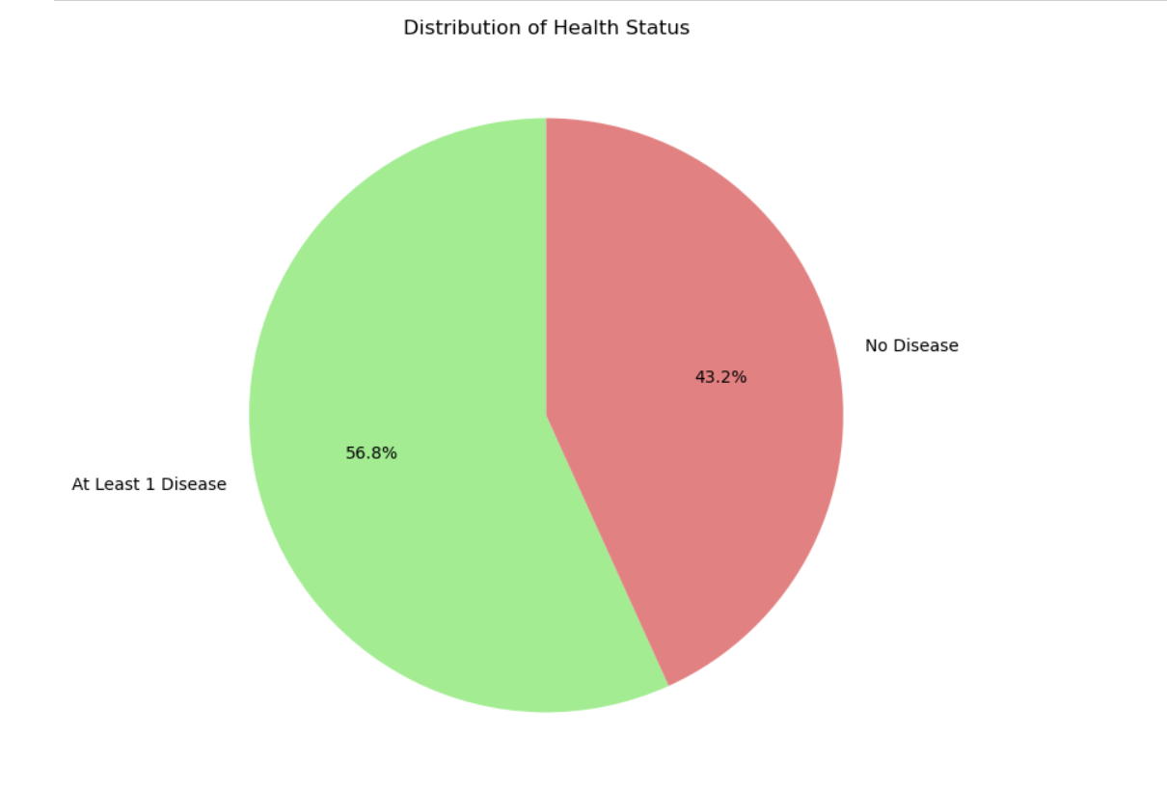
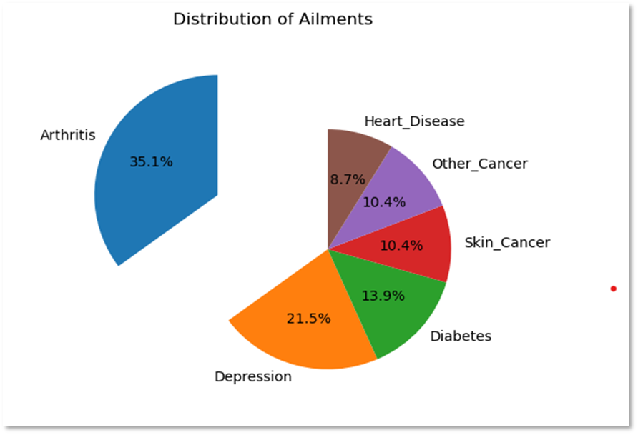
Dataset Highlights

Slide 4

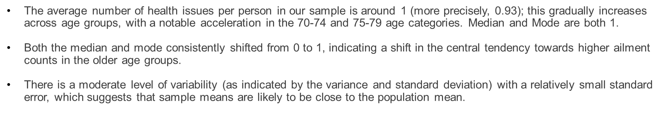
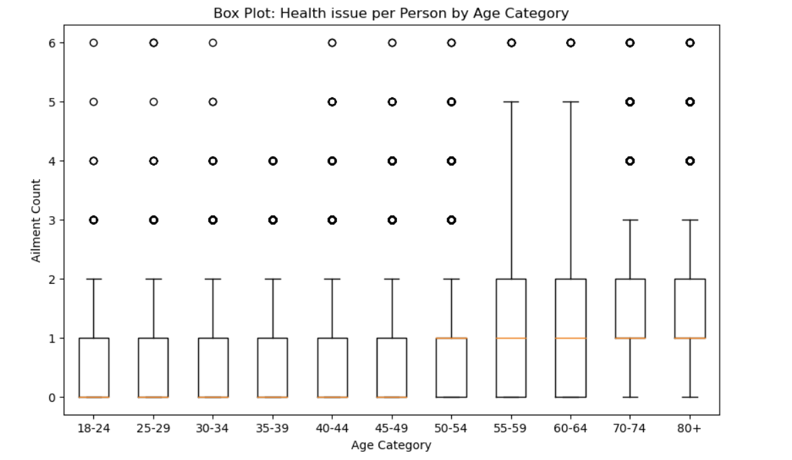
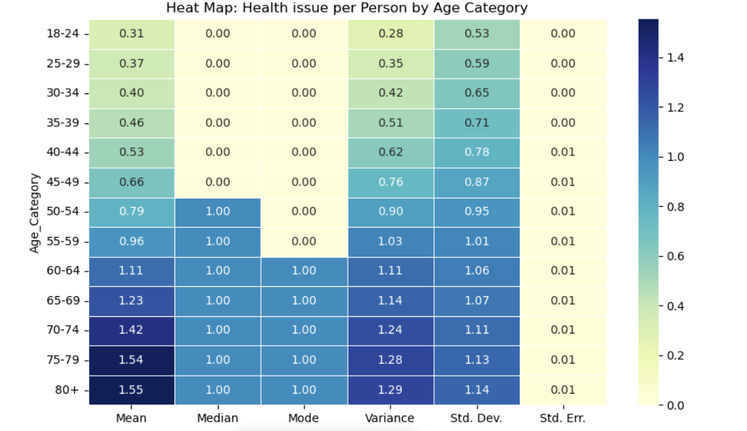

Slide 5
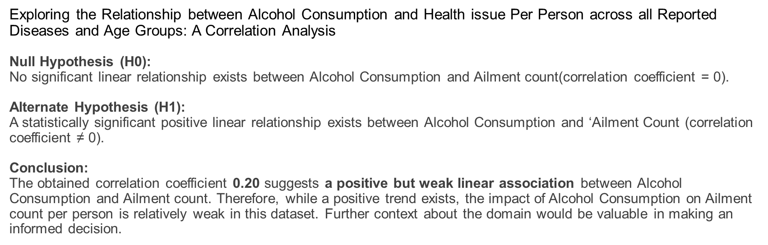
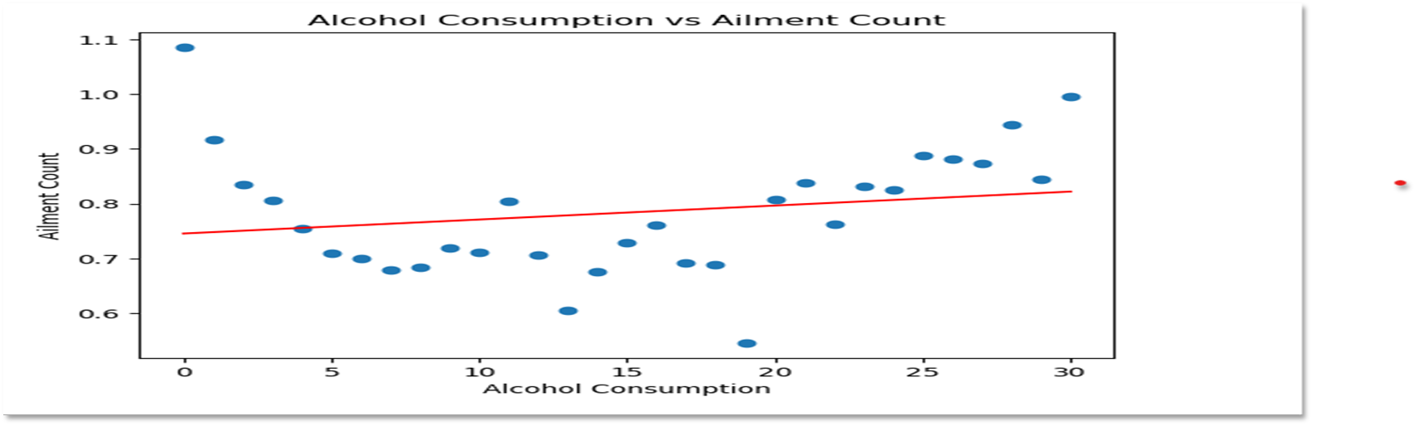

Slide 6
Deep dive into selected Health issues

Slide 7
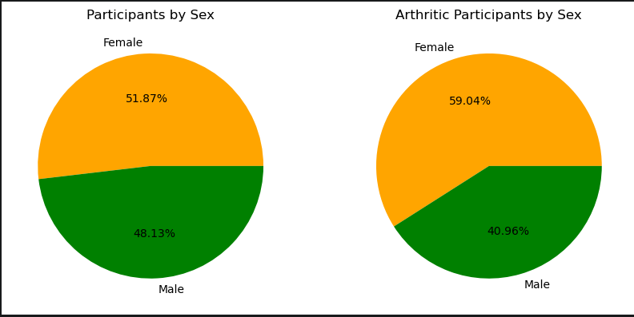
Arthritis
Arthritis occurs the most frequently with 32.7% of the participants reporting this health issue. When we looked into the data, we found the incidence of arthritis was higher for female participants than male participants. Given this we wanted to determine if the difference could be explained by randomness or whether the difference was statistically significant

Slide 8
Chi-Square Contingency Table Analysis Arthritis by Sex
Count of Candidates | No Arthritis | With Arthritis
Female | 100528 | 59668
Male | 107255 | 41403
We chose to put the incidence of Arthritis by Sex through a Chi-Square as follows:
Alternative Hypothesis: The occurrence of Arthritis varies significantly by Sex.
Null Hypothesis: The variance in the occurrence of Arthritis is not significant and can be explained by randomness.
Outcome: Using the distribution of individuals who do not have arthritis by sex and comparing that to the observed distribution of individuals who have Arthritis by sex, the chi-square contingency analysis results in a p-value of 0.0. This suggests there is no statistical relationship between the two groups and the observed variation we see is not happening by chance and we must reject the null hypothesis and assume the changes in the incidence of arthritis by sex is significant.

Slide 9
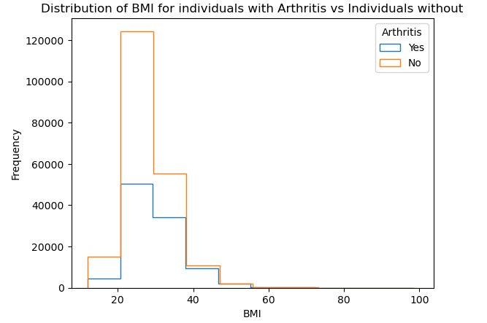
Can a Candidates BMI Impact the incidence of Arthritis?
Investigating further we wanted to determine if the BMI score of a Candidate could impact the incidence of Arthritis. We chose a T-Test

Slide 10
T-Test Arthritis vs BMI for Individuals with Arthritis vs Individuals without Arthritis
Alternative Hypothesis: The BMI score for candidates with Arthritis is statistically different from the BMI scores for candidates without Arthritis.
Null Hypothesis: The variance in the BMI scores is not significant and can be explained by randomness.
Outcome: the p-value of 0.0 indicates the variance in the means of people with Arthritis vs people without Arthritis is statistically significant and not happening by chance and therefore incidence of Arthritis is influenced by a person's BMI

Slide 11
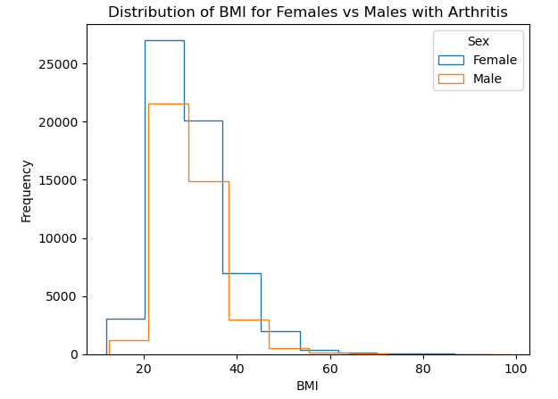
Can the Variance in the Occurrence of Arthritis by Sex be explained by differences in BMI by Sex?
There appears to be variance in the BMI scores for Females vs Males for the candidates with Arthritis. Can this explain the variance in the incidence of Arthritis between the two groups?

Slide 12
T-Test of Arthritis vs BMI for Females with Arthritis vs Males with Arthritis
Alternative Hypothesis: The incidence of arthritis is related to the difference in BMI score for each sex.
Null Hypothesis: The incidence of arthritis in individuals is unrelated to the BMI scores for each sex and the difference in the mean BMI between to the two groups we are seeing is to be expected by chance.
Outcome: a T-test yielded a p-value of 0.08 when assessed at a confidence level of 95% indicates the variance in the mean we are seeing may be happening by chance and the incidence of Arthritis appears unrelated to the BMI of each sex. Therefore, or the difference in the incidence of Arthritis by sex can NOT be explained by the difference in BMI scores.

Slide 13
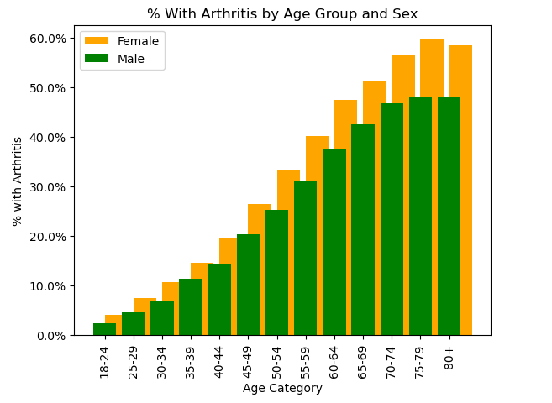
The Incidence of Arthritis by Age
The incidence of Arthritis increases with age, could the difference in the incidence of arthritis by related to the difference in the relative ages of female candidate's vs male?

Slide 14
Chi Square Contingency Table Analysis - Age
Female Male
Age_Category
18-24 8215 10466
25-29 7118 8376
30-34 8963 9465
35-39 10367 10239
40-44 11203 10392
45-49 11000 9968
50-54 12968 12129
55-59 14660 13394
60-64 16969 15449
65-69 17427 16007
70-74 16739 14364
75-79 11400 9305
80+ 13167 9104
We put all candidates into a table by age category and sex in an effort to determine if the variance we see in the incidence of Arthritis.
Alternative Hypothesis: The distribution of candidates by age category and sex contributes to the variance we are seeing in the variance in the incidence of Arthritis we see by sex Alone.
Null Hypothesis: The variance we see in the distribution in candidates by Sex and Age Category is not significant and can be explained by randomness.
Outcome: The Chi-Square Contingency Table yields a p-value of nearly 0.0 indicating the variance in the incidence of Arthritis by sex can be related to the variance in Age by Females vs Males.

Slide 15
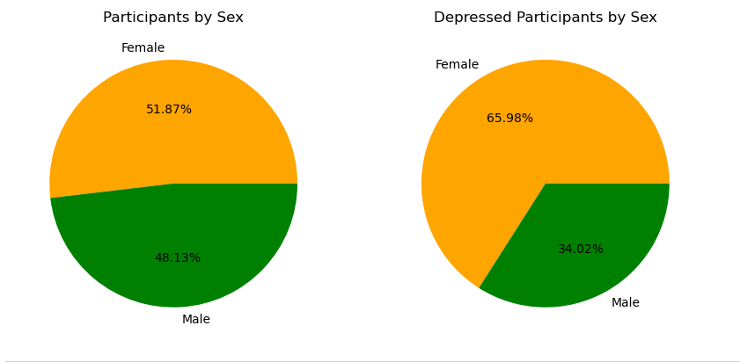
Analysis of depression
In the data set depression is diagnosed in 20% of the total participants.
The sex of the participants was nearly even; (F)52% : (M)48%
Our preliminary analysis discovered that depression was 32% more prevalent in the female participants.

Slide 16

Further Analysis
In order to determine if there was evidence of a statistically significant association between depression and sex we conducted a chi-square contingency table analysis.
Alternative Hypothesis (H1): The incidence of depression is related to the sex of an individual.
Null Hypothesis (H0): The distribution of individuals with depression is unrelated to the sex of the individual, & any observed variance is due to chance.
Outcome: The chi-square contingency analysis yields a p-value of 0.0, which is less than 0.05, and so we must reject the null hypothesis in favour of the alternative.
We thus conclude that there is a statistically significant relationship between the incidence of depression and the sex of the individual.

Slide 17
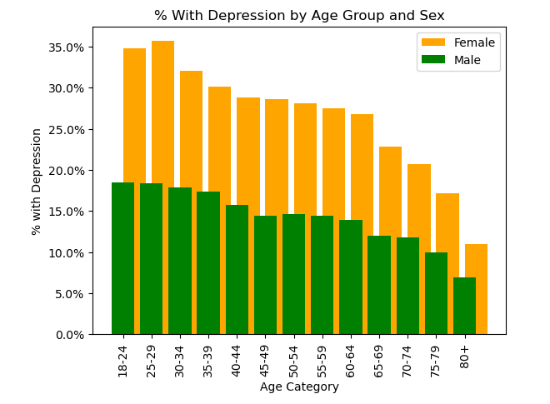
Analysis by Age
In another analysis we also found that the incidence of depression decreases with age.
This indicates that the prevalence of depression in females may be influenced by the variance in the distribution of males and females in different age groups.
(If the incidence of depression decreases with age, the higher percentage of older males in the data set may influence the lower count of depression in men)

Slide 18
Final Conclusions
Arthritis:
There is a strong relationship dectected between the incidence of arthritis and sex, where women appear to have a higher incidence of arthritis when compared to men. Analysis shows the incidence of arthritis is related to an individuals BMI score and age but neither of these factors appear to explain the delta in the frequency of arthritis by sex within the studied population.
Depression:
We detected a strong relationship between the incidence of depression and sex, where women experience depression at a higher rate than men. This variance holds through all age categories. Unlike the incidence of Arthritis however, the incidence of depression appears to decline as individuals age.

Slide 19
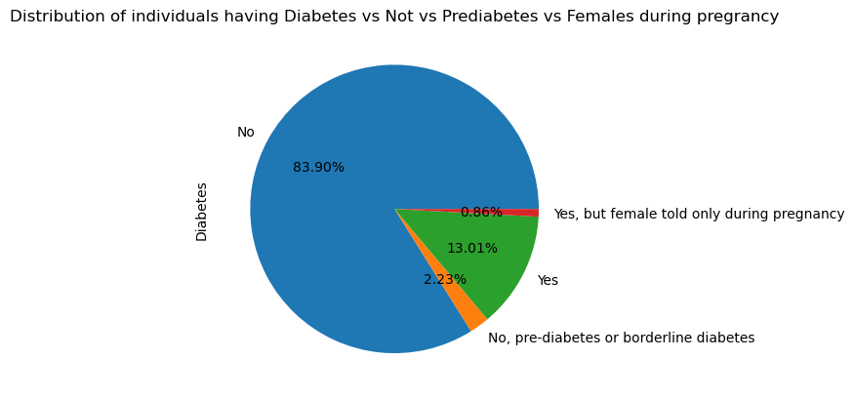
Diabetes
This visual representation illustrates the overall prevalence of Diabetes and non-Diabetes among a group of individuals.
The chart categorizes the Diabetes dataset into four groups: "Yes," "No," "Yes, but reported only during pregnancy for females," and "No, pre-diabetes or borderline diabetes."
According to the chart, the majority of individuals in the dataset are not diagnosed with Diabetes.

Slide 20
One Way ANOVA for Weight by Age Category for Individuals with Diabetes
Alternative Hypothesis:
There is a statistically significant difference in Weight scores based on Age Category for people with Diabetes.
Null Hypothesis:
The mean Weight by age category are statistically the same.
Analysis
The One-Way ANOVA test yields a statistic of 176.3 and a p-value of 0.0, therefore we must reject the null hypothesis in favor of the Alternative hypothesis and conclude the means of Weight are statistically influenced by the age category.

Slide 21
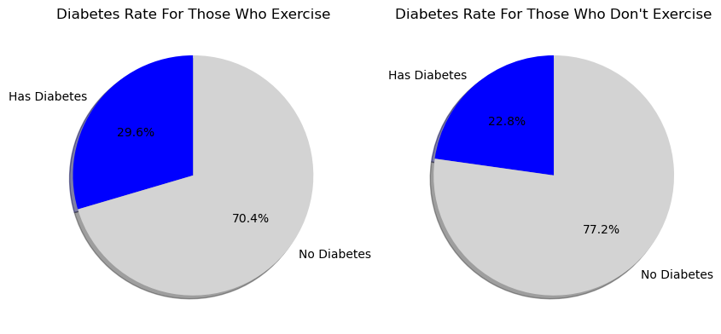
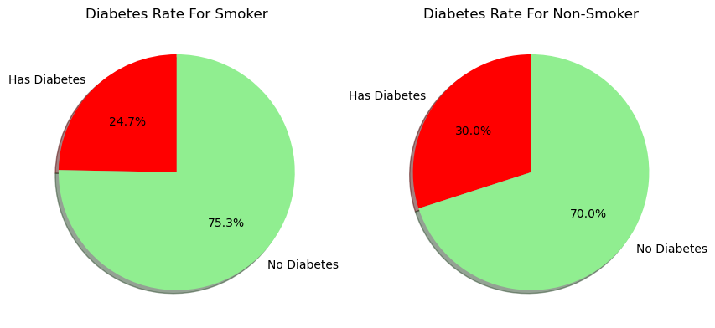
Comparing Behaviour Pattern of individuals from the data set
The initial visualization compares individuals with diabetes who engage in exercise 29.6% versus those who do not 22.8%.
The second visualization contrasts individuals with diabetes who smoke 24% with those who do not smoke 30%.
When considering both behaviors based on the dataset, the visualizations indicate that neither engaging in exercise nor smoking appears to be associated with the presence of diabetes in individuals.

Slide 22
Conclusion:
Diabetes:
The analysis reveals a minimal correlation between diabetes and individuals who maintain consistent smoking or exercise habits.
The data suggests that there is little connection between an individual's weight and the likelihood of having diabetes, as observed in the dataset.

Slide 23
Other Cancer
What are we looking for?
Correlations between other cancers and the following factors:
# of Alcohol Consumption
# of Fruit Consumption
# of Green Vegetables Consumption
# of Fried Potato Consumption
Smoking History (Yes/No)
Exercise (Yes/No for the past few months)

Slide 24
Other Cancer
Null Hypotheses
There is no significant difference in alcohol consumption between those who has other cancer and doesn't.
There is no significant difference in fruit consumption does between those who has other cancer and doesn't.
There is no significant difference in green vegetables consumption does between those who has other cancer and doesn't.
There is no significant difference in fried potato consumption does between those who has other cancer and doesn't.
There is no significant difference in other cancer rate between smokers and non-smokers.
There is no significant difference in other cancer rate between those who exercise and don't.

Slide 25
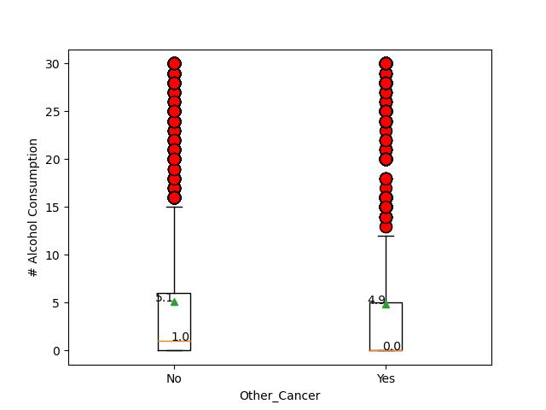
Other Cancer: Alcohol Consumption
 | No | Yes
Population | 278976 | 29878
Mean | 5.1 | 4.9
Median | 1.0 | 0
T-test p-value | 4.304e-06

Slide 26
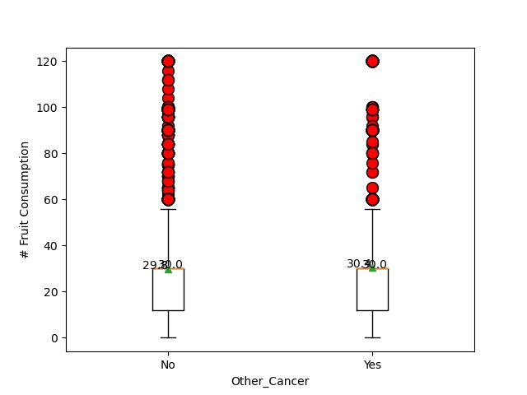
Other Cancer: Fruit Consumption
 | No | Yes
Population | 278976 | 29878
Mean | 29 | 30
Median | 30 | 30
T-test p-value | 9.88e-06

Slide 27
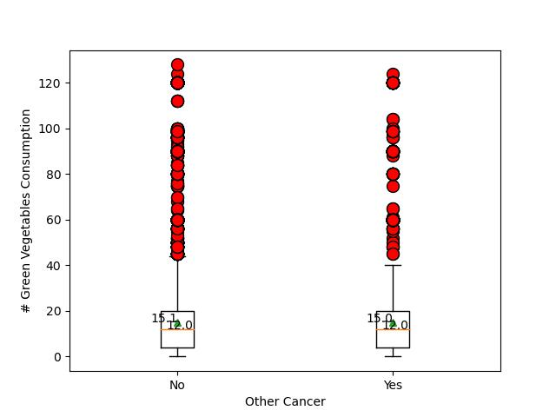
Other Cancer: Green Vegetables Consumption
 | No | Yes
Population | 278976 | 29878
Mean | 15.1 | 15.0
Median | 12.0 | 12.0
T-test p-value | 0.062

Slide 28
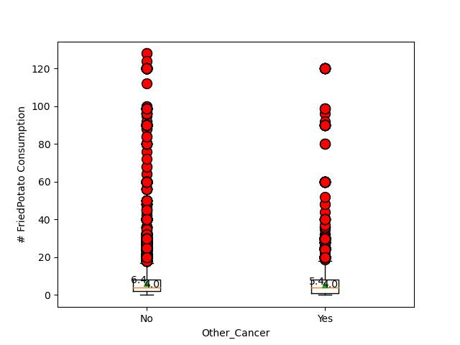
Other Cancer: Fried Potato Consumption
 | No | Yes
Population | 278976 | 29878
Mean | 6.4 | 5.4
Median | 4.0 | 4.0
T-test p-value | 2.69e-85

Slide 29
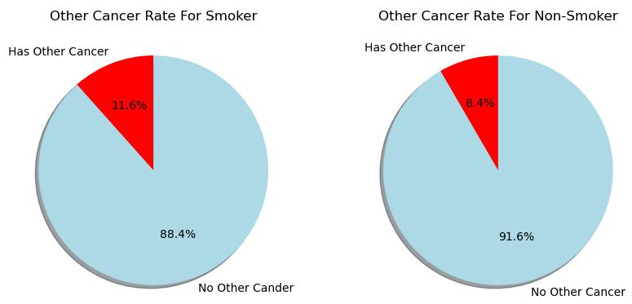
Other Cancer: Smoking History
Contingency Chi-Square | Has Other Cancer | No Other Cancer
Smoker | 14513 | 110751
Non Smoker | 15365 | 168225
A p-value of 1.10e-193 indicates rejection of null hypothesis.

Slide 30
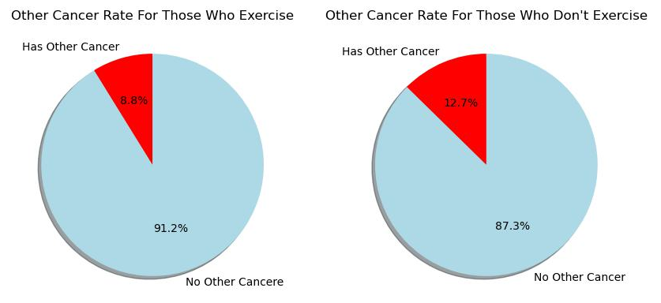
Other Cancer: Exercise
Contingency Chi-Square | Has Other Cancer | No Other Cancer
Do Exercise | 21084 | 218297
Don’t Exercise | 8794 | 60679
A p-value of 1.35e-200 indicates rejection of null hypothesis.

Slide 31
Other Cancer
Results
There IS a significant difference in alcohol consumption between those who has other cancer and doesn't.
There IS a significant difference in fruit consumption does between those who has other cancer and doesn't.
There IS a significant difference in green vegetables consumption does between those who has other cancer and doesn't.
There IS a significant difference in fried potato consumption does between those who has other cancer and doesn't.
There IS a significant difference other cancer rate between smokers and non-smokers.
There IS a significant difference other cancer rate between those who exercise and don't.

Slide 32
Other Cancer
Results
The alcohol consumption is higher on people without other cancer.
The fruit consumption is higher on people without other cancer.
The green vegetables consumption is higher on people without other cancer.
The fried potato consumption is higher on people without other cancer.
Smokers has a higher rate of other cancer.
People who don’t exercise has a higher rate of cancer.

Slide 33
Heart Disease
What are we looking for?
Correlations between heart disease and the following factors:
# of Alcohol Consumption
# of Fruit Consumption
# of Green Vegetables Consumption
# of Fried Potato Consumption
Smoking History (Yes/No)
Exercise (Yes/No for the past few months)

Slide 34
Heart Disease
Null Hypotheses
There is no significant difference in alcohol consumption between those who has heart disease and doesn't.
There is no significant difference in fruit consumption does between those who has heart disease and doesn't.
There is no significant difference in green vegetables consumption does between those who has heart disease and doesn't.
There is no significant difference in fried potato consumption does between those who has heart disease and doesn't.
There is no significant difference in heart disease rate between smokers and non-smokers.
There is no significant difference in heart disease rate between those who exercise and don't.

Slide 35
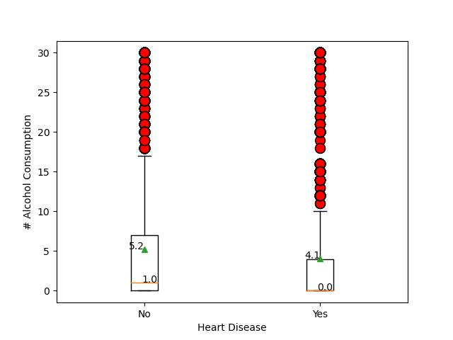
Heart Disease: Alcohol Consumption
 | No | Yes
Population | 283883 | 24971
Mean | 5.2 | 4.1
Median | 1.0 | 0
T-test p-value | 2.56e-06

Slide 36
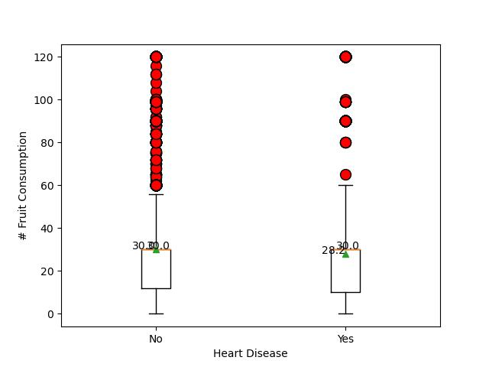
Heart Disease: Fruit Consumption
 | No | Yes
Population | 283883 | 24971
Mean | 30.0 | 28.2
Median | 30.0 | 30.0
T-test p-value | 1.12e-29

Slide 37
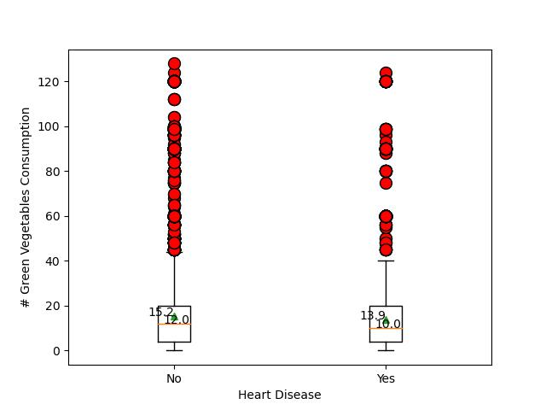
Heart Disease: Green Vegetables Consumption
 | No | Yes
Population | 283883 | 24971
Mean | 15.2 | 13.9
Median | 12.0 | 12.0
T-test p-value | 1.35e-45

Slide 38
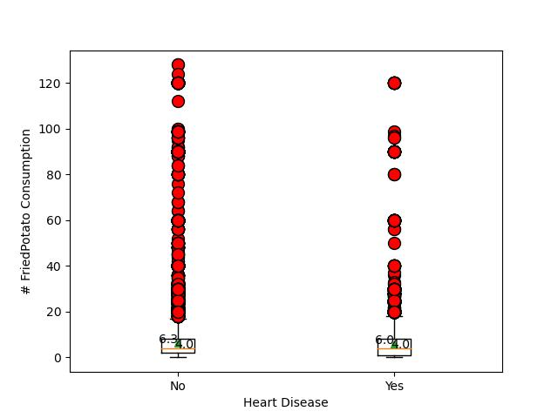
Heart Disease: Fried Potato Consumption
 | No | Yes
Population | 283883 | 24971
Mean | 6.3 | 6.0
Median | 4.0 | 4.0
T-test p-value | 2.36e-07

Slide 39
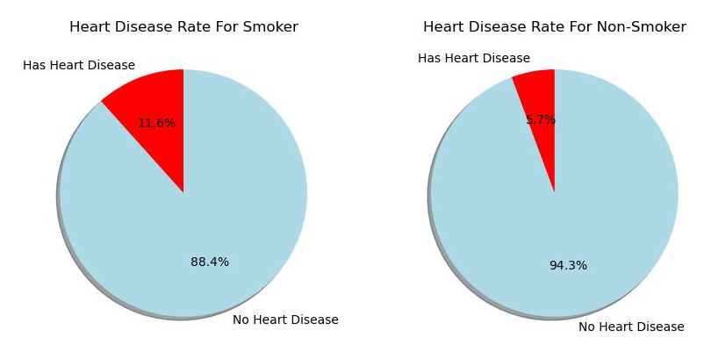
Heart Disease: Smoking History
Contingency Chi-Square | Has Heart Disease | No Other Cancer
Smoker | 14584 | 110680
Non Smoker | 10387 | 173203
A p-value of 0 indicates rejection of null hypothesis.

Slide 40
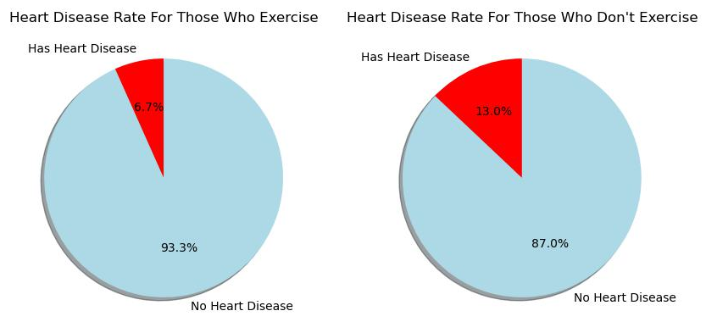
Heart Disease: Exercise
Contingency Chi-Square | Has Heart Disease | No Other Cancer
Do Exercise | 15967 | 223414
Dont’ t Exercise | 9004 | 60469
A p-value of 0 indicates rejection of null hypothesis.

Slide 41
Heart Disease
Results
There IS a significant difference in alcohol consumption between those who has heart disease and doesn't.
There IS a significant difference in fruit consumption does between those who has heart disease and doesn't.
There IS a significant difference in green vegetables consumption does between those who has heart disease and doesn't.
There IS a significant difference in fried potato consumption does between those who has heart disease and doesn't.
There IS a significant difference heart disease rate between smokers and non-smokers.
There IS a significant difference heart disease rate between those who exercise and don't.

Slide 42
Heart Disease
Results
The alcohol consumption is higher on people without heart disease.
The fruit consumption is higher on people without heart disease.
The green vegetables consumption is higher on people without heart disease.
The fried potato consumption is higher on people without heart disease.
Smokers has a higher rate of heart disease.
People who don’t exercise has a higher rate of heart disease.

